Slide 1

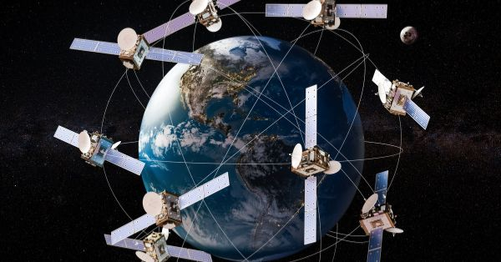
NETWORK SLICING IN SATELLITE SYSTEMS FOR RAN
FINAL PRESENTATION
EEC 655 SATELLITE COMMUNICATIONS
Dr. Mehdi Rahmati
presented by
Nikhil Reddy Kuntloor (2909957)
Supriya Rayabandi (2898618)

Slide 2
INTRODUCTION
In this project, we focus on how satellite networks can support 5G and future 6G services. Network slicing allows us to divide a single network into multiple virtual slices, each optimized for a different service like high-speed data, low-latency communication, or IoT.
Satellite RAN faces challenges like limited spectrum and long delays, so slicing helps manage resources efficiently, ensuring each service gets the performance it needs. This project studies how to design and evaluate network slicing in satellite RAN.

Slide 3
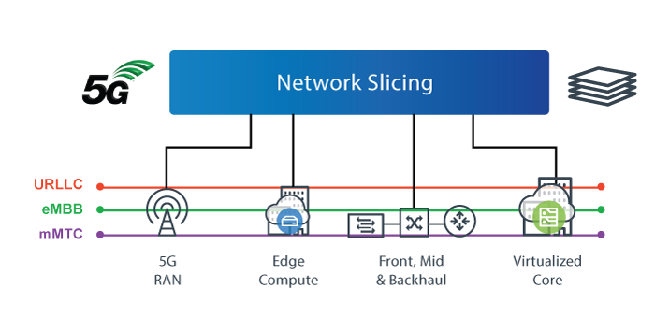
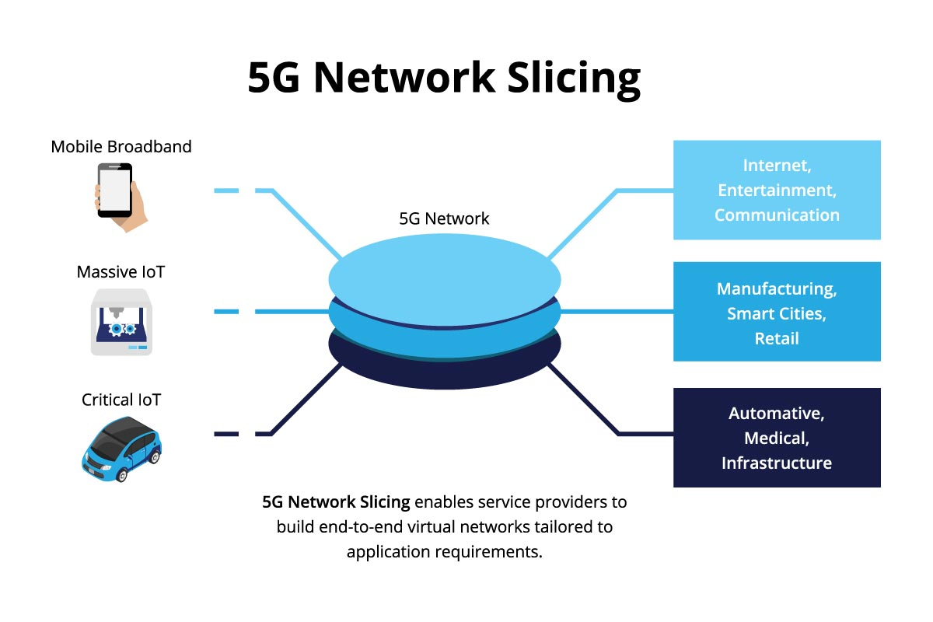
WHAT IS NETWORK SLICING
Divides a single physical network into multiple virtual slices.
Each slice is optimized for a specific service with its own resources and QoS.
Allows services like high-speed internet, low-latency communication, and IoT to run simultaneously without affecting each other.

Slide 4
WHY NETWORK SLICING IN SATELLITE RAN
Supports different services (IoT, broadband, emergency) with different QoS needs.
Optimizes limited satellite resources efficiently.
Provides isolation so one service doesn’t affect others.
Enables flexible, on-demand network management.
Ensures end-to-end 5G/6G service consistency across terrestrial and satellite networks.

Slide 5
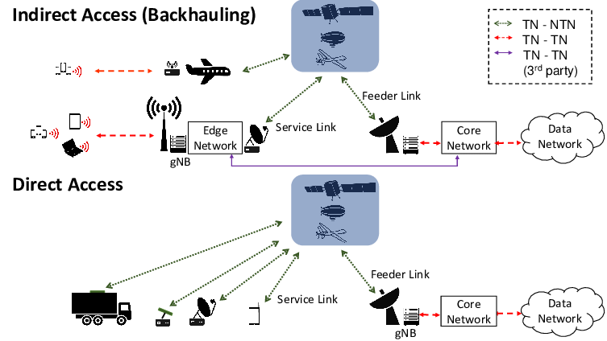
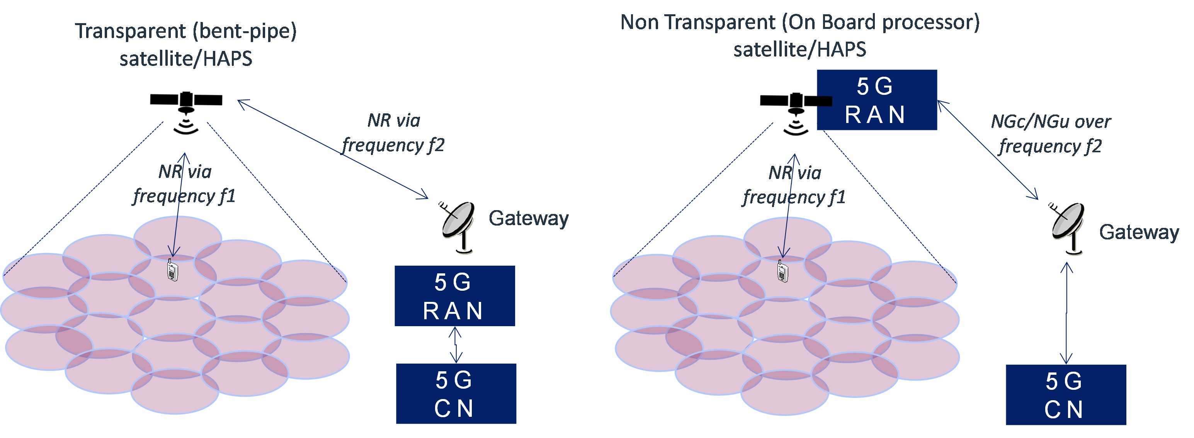
RAN ARCHITECTURE
Connects users to the core network through satellites, managing all radio communications.
gNB (Base Station): Handles radio signals to and from user devices.
CU (Central Unit): Manages control functions like signaling and network coordination.
DU (Distributed Unit): Processes data in real-time, schedules resources, and manages lower-layer protocols.

Slide 6
SATELLITE PAYLOAD TYPES
Transparent payload: Satellite acts as a relay, all processing is on the ground.
Regenerative payload: Satellite can process signals onboard, reducing latency.
Supports QoS, resource allocation, mobility, and network slicing, enabling flexible and reliable service for diverse applications.

Slide 7
SATELLITE ORBIT
Low Earth Orbit (LEO) satellites are considered in this project because they provide much lower latency compared to GEO and MEO systems.
Operating at an altitude of a few hundred to a couple of thousand kilometers, LEO satellites are well suited for 5G-like services that require fast response times.
Their use of large constellations enables continuous coverage and better capacity, making them suitable for RAN-level functions such as MAC-layer scheduling and network slicing.

Slide 8
NETWORK SLICING CONCEPT
Network slicing divides a single satellite RAN infrastructure into multiple logical networks (slices).
Each slice is designed to meet specific service requirements such as latency, bandwidth, and reliability.
It enables efficient utilization of limited satellite resources like spectrum and power.
Slices are isolated, ensuring that performance issues in one slice do not affect others.
Slicing is mainly supported at the RAN (MAC/PHY) layer through scheduling and resource allocation.
Provides end-to-end service continuity for 5G/6G across terrestrial and satellite networks.

Slide 9
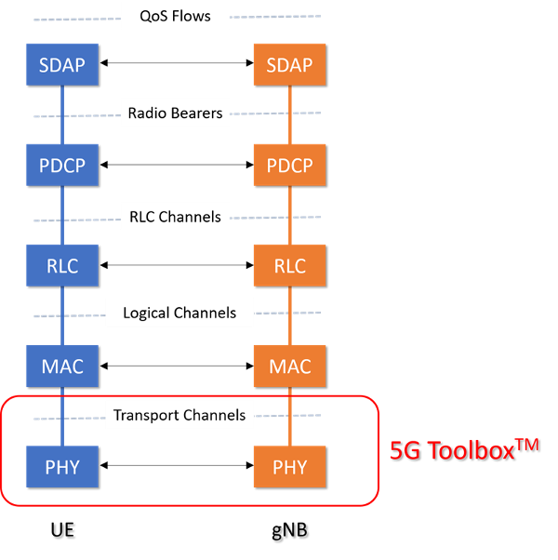
RAN LAYER-WISE SLICING
Network slicing in RAN is applied across multiple protocol layers.
PHY Layer : Controls physical resources such as spectrum, power, and satellite beams shared among slices.
MAC Layer: Performs slice-aware scheduling, assigns time–frequency resources, and enforces QoS per slice.
RLC Layer: Ensures reliability and packet management separately for each slice.
PDCP Layer: Handles security, mobility, and data integrity per slice.

Slide 10
Proposed System Architecture
UE’S
Satellite (Regenerative Payload)
[ PHY + MAC slicing ]
Gateway / gNB-CU
5G Core

Slide 11
SLICE TYPES & USE CASES
Slice Type | Service Characteristics | Satellite Use Cases
eMBB (Enhanced Mobile Broadband) | High data rate, moderate latency | Video streaming, broadband internet, remote connectivity
mMTC (Massive Machine-Type Communication) | Low data rate, massive device support | IoT sensors, smart agriculture, environmental monitoring
URLLC (Ultra-Reliable Low-Latency Communication) | Ultra-low latency, high reliability | Emergency services, disaster recovery, mission-critical links

Slide 12
Resource Allocation in Satellite RAN
Distributes limited satellite resources among multiple network slices.
Performed at Satellite RAN (gNB / Gateway / On-board processor)
Allocates bandwidth, power, time slots, and beams.
Slice-aware for QoS needs:
eMBB: high throughput
URLLC: low latency
mMTC: massive connectivity
Ensures QoS isolation and fairness.
Optimizes spectrum use despite satellite constraints.

Slide 13
ADVANTAGES OF NETWORK SLICING IN SATELLITE RAN
Efficient Resource Utilization Satellite bandwidth and power are allocated per slice, reducing waste.
Support for Heterogeneous Services Different slices can handle eMBB, URLLC, and mMTC simultaneously.
QoS Guarantees Each slice gets defined latency, throughput, and reliability.
Service Isolation Problems in one slice do not affect other slices.
Alignment with 5G NTN Vision Supports next-generation non-terrestrial network requirements.

Slide 14
FUTURE SCOPE
AI-Powered Adaptive Slicing – Let the satellite automatically adjust resources for each slice.
Multi-Orbit Slicing – Apply slicing across LEO, MEO, and GEO satellites for better coverage.
Integration with Terrestrial 5G/6G – Connect satellite and ground networks smoothly.
Smarter Slice Management – Make slice creation, scaling, and isolation more intelligent.
Support for New Applications – Help IoT, autonomous vehicles, VR/AR, and remote healthcare run efficiently.

Slide 15
CONCLUSION
Network slicing is essential for satellite RAN – It lets multiple services run efficiently.
Regenerative payload enables effective slice control – Onboard processing makes it possible.
MAC and PHY layers play a key role – They handle scheduling, resource allocation, and QoS.
Aligned with 3GPP NTN standards – The design matches 5G satellite network guidelines.

Slide 16

THANK YOU
ANY QUESTIONS?

